Slide 1

SMOKING
AND
PERIODONTAL DISEASE
Dr. HEMA DUDDUKURI
ASST.PROFESSOR
DEPT. OF PERIODONTICS

Slide 2

As many as 6.25 trillion cigarettes are smoked annually across the globe.
Tobacco kills 6 million people each year.
Only 15% of people worldwide have access to smoking cessation services.
About 18% of people worldwide are protected by smoke-free laws.

Slide 3
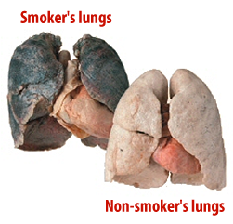
SMOKING KILLS?!
Harmful to almost every organ in the body
Associated with multiple diseases
Reduce life expectancy and quality of life.
Diseases associated with smoking include:
  lung cancer, heart disease, stroke, emphysema, bronchitis, and
  cancers of the oral cavity, bladder, kidney, stomach, liver, and cervix.
Most deaths from smoking are due to lung cancer, chronic obstructive pulmonary disease, and coronary heart disease.

Slide 4
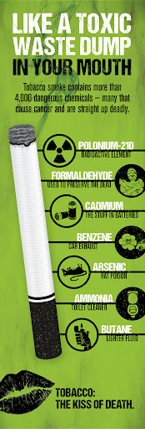
WHAT DOES THE SMOKE CONTAIN?
contains thousands of noxious chemicals
  gaseous phase and a solid (particulate) phase.
The gas phase:
  carbon monoxide,
  ammonia,
  formaldehyde,
  hydrogen cyanide,
  many other toxic and irritant compounds,
The particulate phase:
  nicotine,
  “tar” (itself made up of many toxic chemicals),
  benzene, and benzo(a)pyrene.
including more than 60 known carcinogens such as benzo(a)pyrene & dimethylnitrosamine.

Slide 5
Tar:
  is inhaled with the smoke.
  In its condensate form, it is the sticky brown substance that stains fingers and teeth yellow and brown.
Nicotine:
  an alkaloid
  found within the tobacco leaf and evaporates when the cigarette is lighted.
  It is quickly absorbed in the lungs, and it reaches the brain within 10–19 seconds.
  highly addictive.
  It causes a rise in blood pressure, increased heart and respiratory rates, and peripheral vasoconstriction.

Slide 6
Challenge of Assessing Smoking Status
All dental patients must be asked about their smoking status or tobacco usage.
Current smoking status is the minimal information that must be recorded (e.g., “Patient is currently smoking X cigarettes per day”), but the importance of cumulative exposure to cigarette smoke means that it is more appropriate to record pack-years of smoking.
Pack-years = Number of packs smoked per day × Number of years of smoking

Slide 7
When is a Smoker Not a Smoker?
According to Centers for Disease Control (CDC) and Prevention, the smokers are classified as:
  Smokers: have smoked ≥100 cigarettes in their lifetime and currently smoke.
  Former smokers: have smoked ≥100 cigarettes in their lifetime and do not currently smoke.
  Nonsmokers: have not smoked ≥100 cigarettes in their lifetime and do not currently smoke.

Slide 8
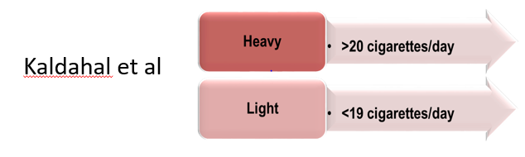
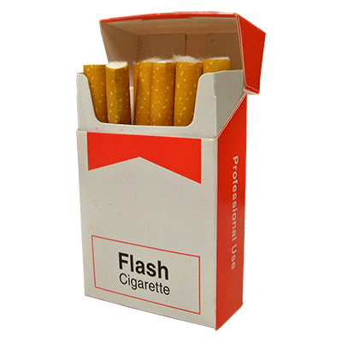

Slide 9
EFFECTS ON ORAL HEALTH
Halitosis:
Foul offensive odour , characteristically seen in smokers.
Not only causes bad breath by itself but also encourages development of hairy tongue which traps food debris.

Slide 10
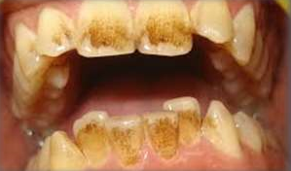
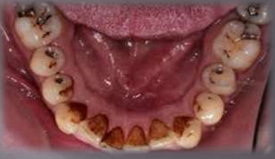
Teeth staining :
Pigmented deposits that appear on teeth are called stains.
Tobacco stains are Tenacious Brown or Black deposits seen on the teeth.
Tooth staining is caused by the Nicotine and Tar found in cigarettes.

Slide 11
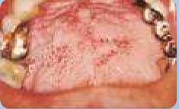
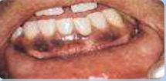
OTHER LESIONS:
SMOKER’S PALATE - Palate becomes white with tiny red spots-raised duct opening of salivary glands [dried mud appearance].
SMOKER’S MELANOSIS -Brown spots on oral mucosa.

Slide 12
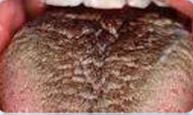
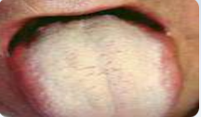
HAIRY TONGUE - Overgrowth of papilla on the surface of tongue.
COATED TONGUE - Tongue coated with food particles, bacteria and debris from epithelium.

Slide 13
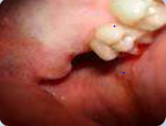
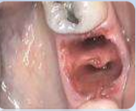
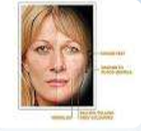
DELAYED WOUND HEALING;
DRY SOCKET;
SMOKER’S FACE.

Slide 14
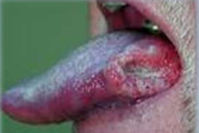
Tobacco use in all forms, especially cigarette smoking, is the number one risk factor for oral cancer.
Possible mechanisms are
•Irritants and toxic substances in tobacco;
•Change in Ph;
•Change in immune response;
•Dryness due to heat produced while smoking.

Slide 15
SMOKING & PERIODONTITIS
Smoking is a major risk factor for periodontitis, and it affects the prevalence, extent, and severity of disease.
In addition, smoking has an adverse impact on the clinical outcome of nonsurgical and surgical therapy as well as the long-term success of implant placement.
Effects of smoking on the prevalence and severity of periodontal diseases
Effects of smoking on the etiology and pathogenesis of periodontal disease
Effects of smoking on the response to periodontal therapy
Effects of smoking cessation on periodontal treatment outcomes

Slide 16
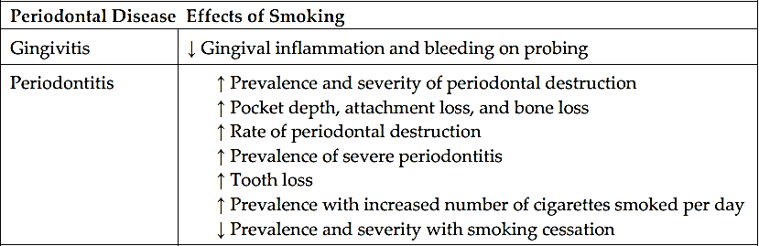
Effects of smoking on the prevalence and severity of periodontal diseases

Slide 17
Data suggest that significant alterations are present in the gingival microvasculature of smokers as compared with nonsmokers and that these changes lead to decreased blood flow and decreased clinical signs of inflammation.
This explains the long-observed phenomenon of a transient increase in gingival bleeding when a smoker quits; patients need to be warned about this phenomenon.

Slide 18
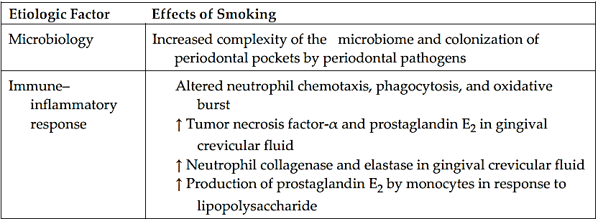
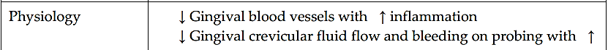
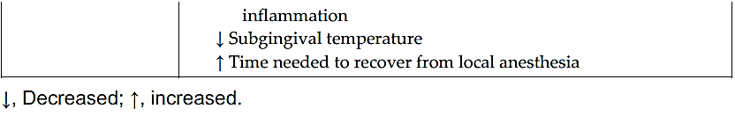
Effects of smoking on the etiology and pathogenesis of periodontal disease

Slide 19
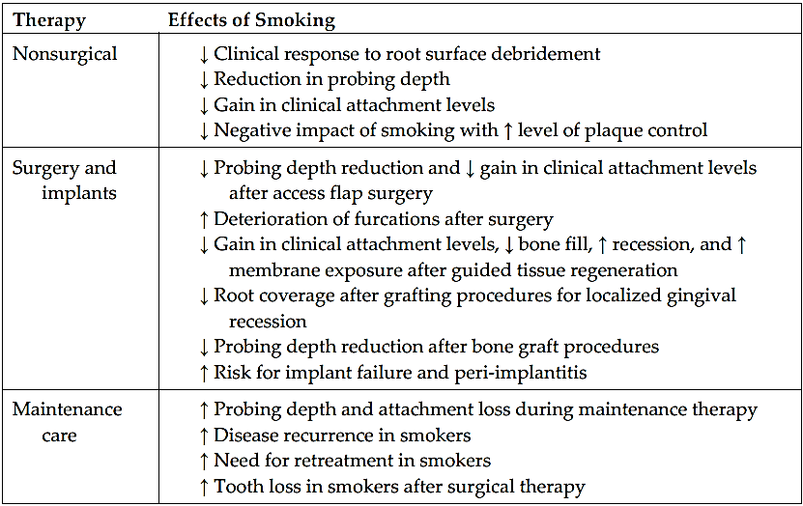
Effects of smoking on the response to periodontal therapy

Slide 20
Effects of smoking cessation on periodontal treatment outcomes
Smoking cessation positively influenced periodontal treatment outcomes.
The benefit of smoking cessation on the periodontium is likely to be mediated through various pathways, such as:
  shift toward a less pathogenic microbiome,
  recovery of the gingival microcirculation, and
  improvements in certain aspects of the immune–inflammatory responses.

Slide 21
It is clear from the studies that:
  smokers may present with periodontal disease at an early age
  they may be difficult to treat effectively with the conventional therapeutic strategies
  they may continue to have progressive or recurrent periodontitis
  they may be at an increased risk of tooth loss or peri-implant bone loss, even when adequate maintenance control is established.
For these reasons, smoking cessation counseling must be a cornerstone of periodontal therapy in smokers.

Slide 22
HELPING YOUR PATIENTS TO QUIT SMOKING
Smoking cessation should be an integral part of periodontal therapy among patients who smoke and should be considered a priority for the management of periodontitis in smokers.
Various methods for helping patients to quit smoking in the dental environment have been described, and these are typically referred to as brief intervention programs.
One such program is known as the 5 A’s:
ASK
ADVISE
ASSESS
ASSIST
ARRANGE

Slide 23
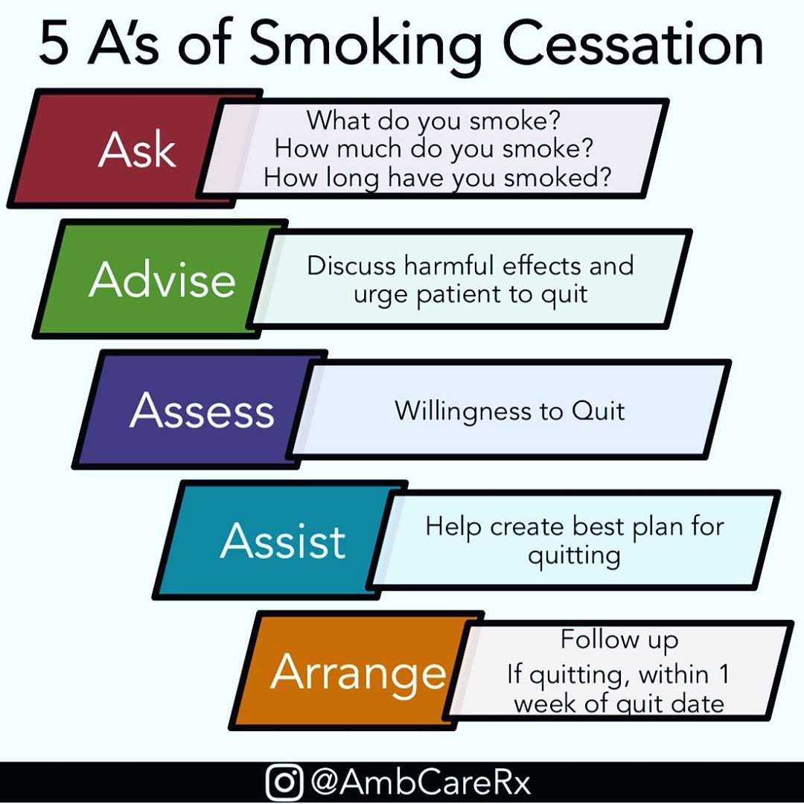
The most important aspect of this strategy is to keep in regular
contact, particularly around the quit date and during the
immediate period after the patient quits.

Slide 24
